Slide 1

OBJECT SIZE DETECTION AND MEASUREMENT
PANAV TYAGI E17CSE184
[Names of the Supervisor]

Slide 2
Introduction
In these days, object detection and dimensioning of objects is an important issue from many areas of industry.
This is a vital topic of computer vision an image problems. This project presents an enhanced technique for detecting objects and computing their measurements

Slide 3
Dataset Used
We have made use of frameworks with python and JavaScript condition to make AI model, front-end/REST-API.
To briefly summarize object measurement, after edge detection and close any gaps between edges, we detect contours by using an OpenCV function that is cv2.findContours to find the shapes of the objects in the edge

Slide 4
Methodology / Model Used
The system consists of two parts which are object detection and object measurement. .
, we need to preprocess our image. The camera will capture a frame and the frame will convert to grayscale to increase quickness and accuracy. Objects are detected via canny edge detector algorithm. It is used to detect only one object or multiple objects.
The final stage of canny edge detector algorithm is hysteresis thresholding. This stage selects which are every edges are surely edges and which aren’t edges. The two threshold values are empirically selected and their definition will upon on the content of a given frame.

Slide 5
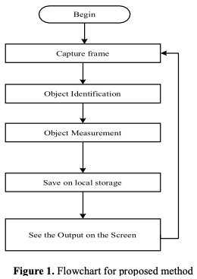
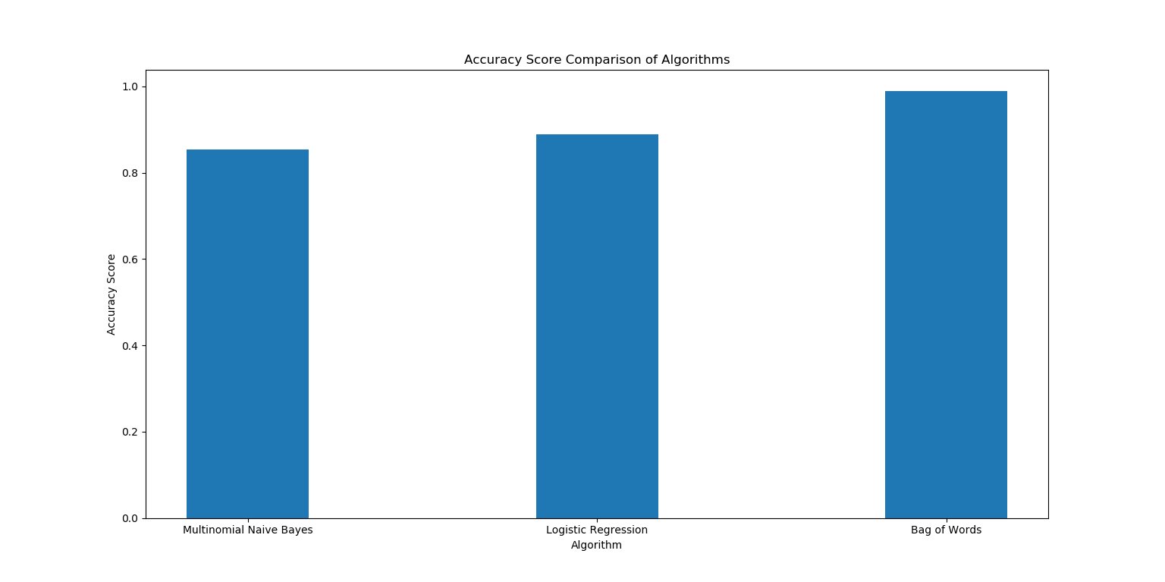
Methodology / Model Used

Slide 6
Results Achieved
We suggested an object measurement technique for real-time video by utilizing OpenCV libraries and includes the canny edge detection, dilation, and erosion algorithms. The suggested technique comprises of four stages: (1) identifying an object to be measured by using canny edge detection algorithm, (2) using morphological operators includes dilation and erosion algorithm to close gaps between edges, (3) find and sort contours, (4) measuring the dimensions of objects. In the implementation of the proposed technique, we designed a system that used OpenCV. The proposed technique was nearly achieved 98% success in determines the size of the objects.

Slide 7
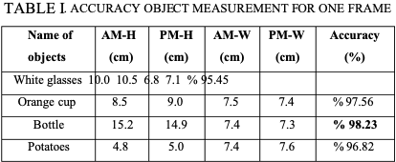
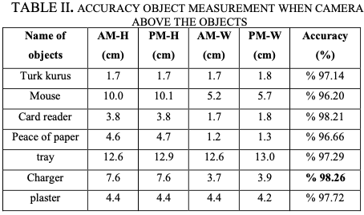
Results Achieved

Slide 8
Conclusion
LIMITATIONS: a powerful real time object measurement method is proposed for industrial systems. In the offered system, Computer Vision used to detect and measure objects. The system can detect and measure objects in a real time video. After the object has been detected by using canny edge detector, the size is obtained for each object by using OpenCV functions. We enhanced the canny edge detector algorithm through utilizing Morphological operations. This procedure benefits to eliminate extra noises. Furthermore, whereas eliminating the extra noises it likewise smoothens the shape and keeps the outline and size of each object. Thus, the outlines of the different objects in the scene were kept.
FUTURE SCOPE: I am planning to use raspberry pi and its on board camera for real time object detection and is measurement even a real time pre-recorded video. Also using the ip camera and an internet connection for real time transmission of feed from a mobile camera and detection

Slide 9
References
PYIMAGESEARCH

Slide 10
Thank You

